Slide 1


Slide 2
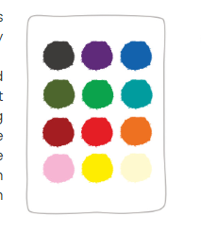
Starter task: Which colour do you feel today and why?

Slide 3

Learning Intentions: Today we are finishing our learning about the nature of God and beginning our thinking about the nature of humanity.
Success Criteria: By the end of the lesson I will:
. Have understood more about Gods nature.
. Have learnt at least one quote
. Have begun to understand the concept of human nature.

Slide 4
Judaism
Beliefs
• beliefs about God
• nature of human beings: yetzer tov; yetzer harah; free will; suffering
• beliefs about Covenant
• judgement; the Messiah; the Messianic Age; Olam Ha’ba
Practices
• living according to the Commandments
• Rosh Hashanah; Yom Kippur
• worship: Shabbat; synagogue

Slide 5
Check Understanding
One God
1: All Knowing
2: All Powerful
3: All Good
The Nature of God in Judaism
The Ultimate Creator
Created the universe and everything in it.
Present everywhere and able to interact with humanity.

Slide 6

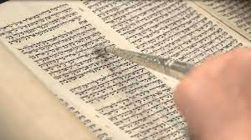
22.8.22 The Nature of God continued.
Human beings can only come to know God by:
  1. Building and maintaining a relationship with him.
  2. By following the commandments and teachings of God, most of which are found in the Torah.

Slide 7
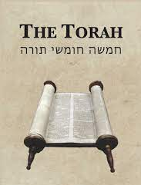
Beliefs about God sources:
God is eternal: “The Lord is the everlasting God.” Isaiah
God is the creator, and he is omnipotent: “In the beginning, God created the heavens and the earth.” Genesis 1:1
God is benevolent: “God is merciful and gracious, slow to anger, and abounding in steadfast love.” Exodus
Now we need to learn them!

Slide 8
“The Lord is the everlasting God.” Isaiah
6 words , use your fingers!, the 5th word has to jump to the 6th, it’s an everlasting jump!

Slide 9
“In the beginning, God created the heavens and the earth.” Genesis 1:1
Imagine the start of a film at the cinema, when it bursts onto screen….. There is God and he’s busy making two things.

Slide 10
“God is merciful and gracious,
slow to anger,
and abounding in steadfast love.” Exodus
4 verbs.

Slide 11
Beliefs about God sources:
God is eternal:
God is the creator, and he is omnipotent:
God is benevolent:

Slide 12

Lets do something with this info!

Slide 13
The 3 skills needed in RMPS are…..
Knowledge and Understanding
Analysis
Evaluation

Slide 14

Knowledge and Understanding
This is what you know and understand about the issue in relation to what the question is asking. (KU)
The skill is to ensure that the knowledge you use in answering the question is relevant to the question being asked.
You get a KU mark for using a quote in a relevant way.
You also get a KU mark for showing knowledge about a topic.
You need 6 KU marks in a 10 mark essay, and 10 in a 20. So a lot of the marks come form KU.

Slide 15
We are going to practice essay writing in our skills jotter.
This should be a different colour to your normal notes jotter!
We are going to write a paragraph about God that is worth 3 KU marks.
The nature of God.
One Jewish belief about the nature of God is that he is omnipotent, which means he is all powerful. Jews also believe God is eternal, meaning he always has been and always will be, this is shown in the Torah when it says “The Lord is the everlasting God.” Isaiah. Finally Jews believe that God is omnipresent which means that he is always present, watching over all of humanity.

Slide 16

Where do you think the 3 KU marks are?
The nature of God.
One Jewish belief about the nature of God is that he is omnipotent, which means he is all powerful. Jews also believe God is eternal, meaning he always has been and always will be, this is shown in the Torah when it says “The Lord is the everlasting God.” Isaiah. Finally Jews believe that God is omnipresent which means that he is always present, watching over all of humanity.

Slide 17
The nature of God.
One Jewish belief about the nature of God is that he is omnipotent, which means he is all powerful. (KU) Jews also believe God is eternal, meaning he always has been and always will be, this is shown in the Torah when it says “The Lord is the everlasting God.” Isaiah. (KU) Finally Jews believe that God is omnipresent which means that he is always present, watching over all of humanity. (KU)

Slide 18
Now, have a go at writing at paragraph yourself which is worth 3 KU marks.
Try and use some different ideas about God’s nature and a different quote.

Slide 19
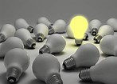
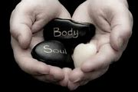
Nature of human beings
Human nature simply means the essential characteristics of human existence, such as birth, growth, morality etc.
Think back to the creation story in Genesis. When did humanity appear?
Humanity was made last because we are unique and special the pinnacle of God’s creation.
Within Judaism, it is believed that Jews are born with a dual nature.

Slide 20
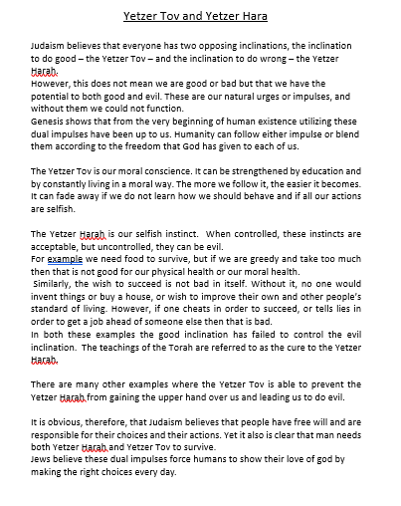
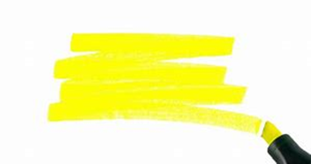
Read through the information sheet highlighting the key pieces of information.
Then stick this into your jotters.

